Slide 1

EE464 Hardware Project Presentation
Group Name: Dragonfly

Slide 2
Specifications
Minimum Input Voltage: 12 V
Maximum Input Voltage: 18 V
Output Voltage: 48 V
Output Power: 48 W
Output Voltage Peak-to-Peak Ripple: 3%
Line Regulation(Deviation of percent output voltage when input voltage is changed from its minimum to maximum or vice versa): 3%
Load Regulation(Deviation of percent output voltage when load current is changed from 10% to 100% or vice versa): 3%

Slide 3
Topology Selection: Flyback Converter
Most common isolated converter
Smaller number of components
Low cost
Less number of turn on the transformer
Easy to control

Slide 4
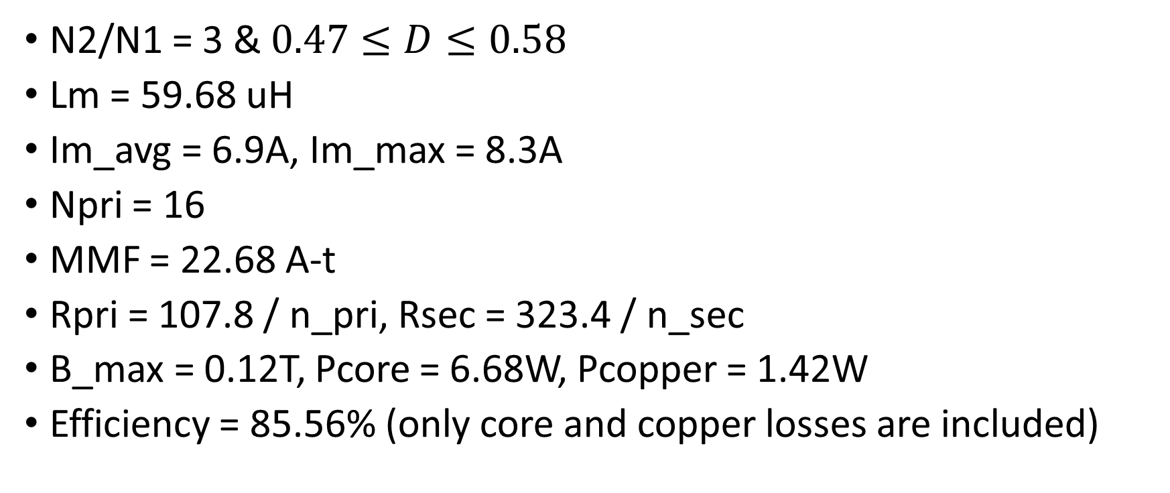
Theoretical Calculations
N2/N1 = 3 & $0.47≤D≤0.58$
Lm = 59.68 uH
Im_avg = 6.9A, Im_max = 8.3A
Npri = 16
MMF = 22.68 A-t
Rpri = 107.8 / n_pri, Rsec = 323.4 / n_sec
B_max = 0.12T, Pcore = 6.68W, Pcopper = 1.42W
Efficiency = 85.56% (only core and copper losses are included)

Slide 5
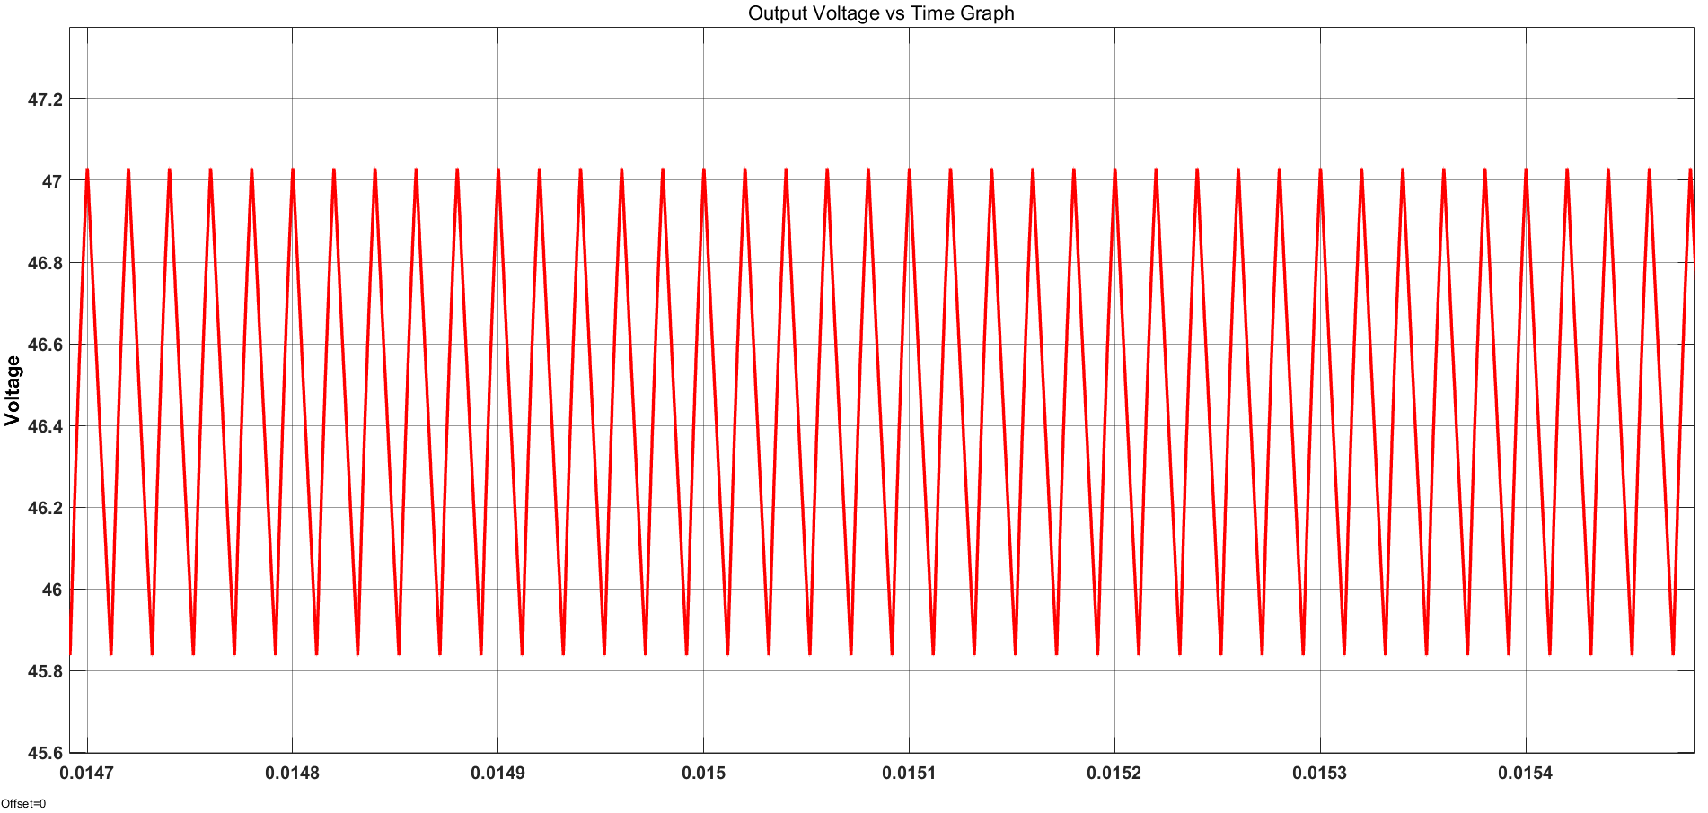

Simulation Results
$$\frac{∆Vo}{Vo}=\frac{1.19}{46.46}∗100=2.56\%$$

Slide 6
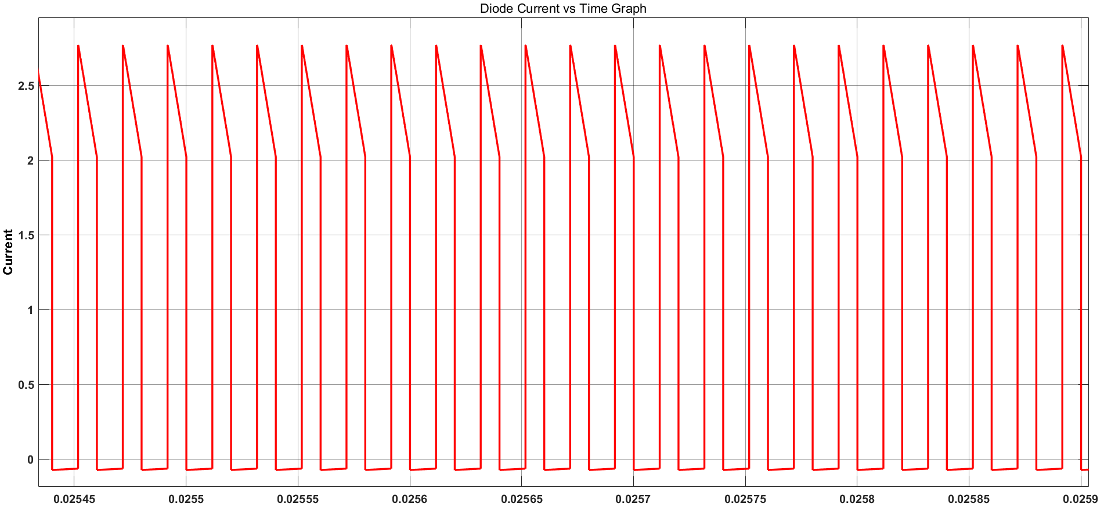
Id_max = 2.77A
Pd_max = 1.07W

Slide 7
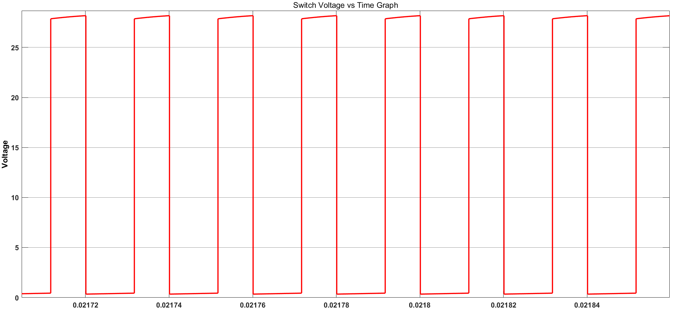
Vsw_max = 28.18V

Slide 8
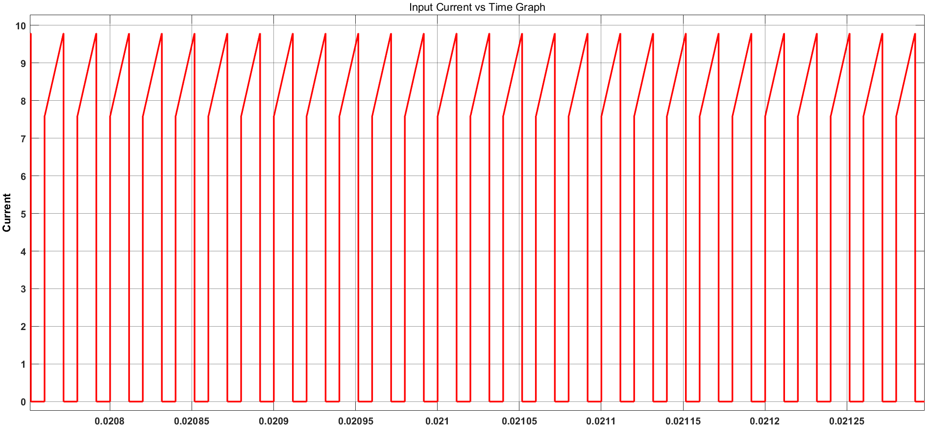
Irms = 6.59A
Psw = 2.21W (cond: 1.92W, switching: 0.29W)

Slide 9
Efficiency Calculations
Load (%) | Vin = 12V | Vin = 18V
25 | 72.2 | 65.9
50 | 77 | 76
75 | 76 | 78.6
100 | 74.4 | 79.3

Slide 10
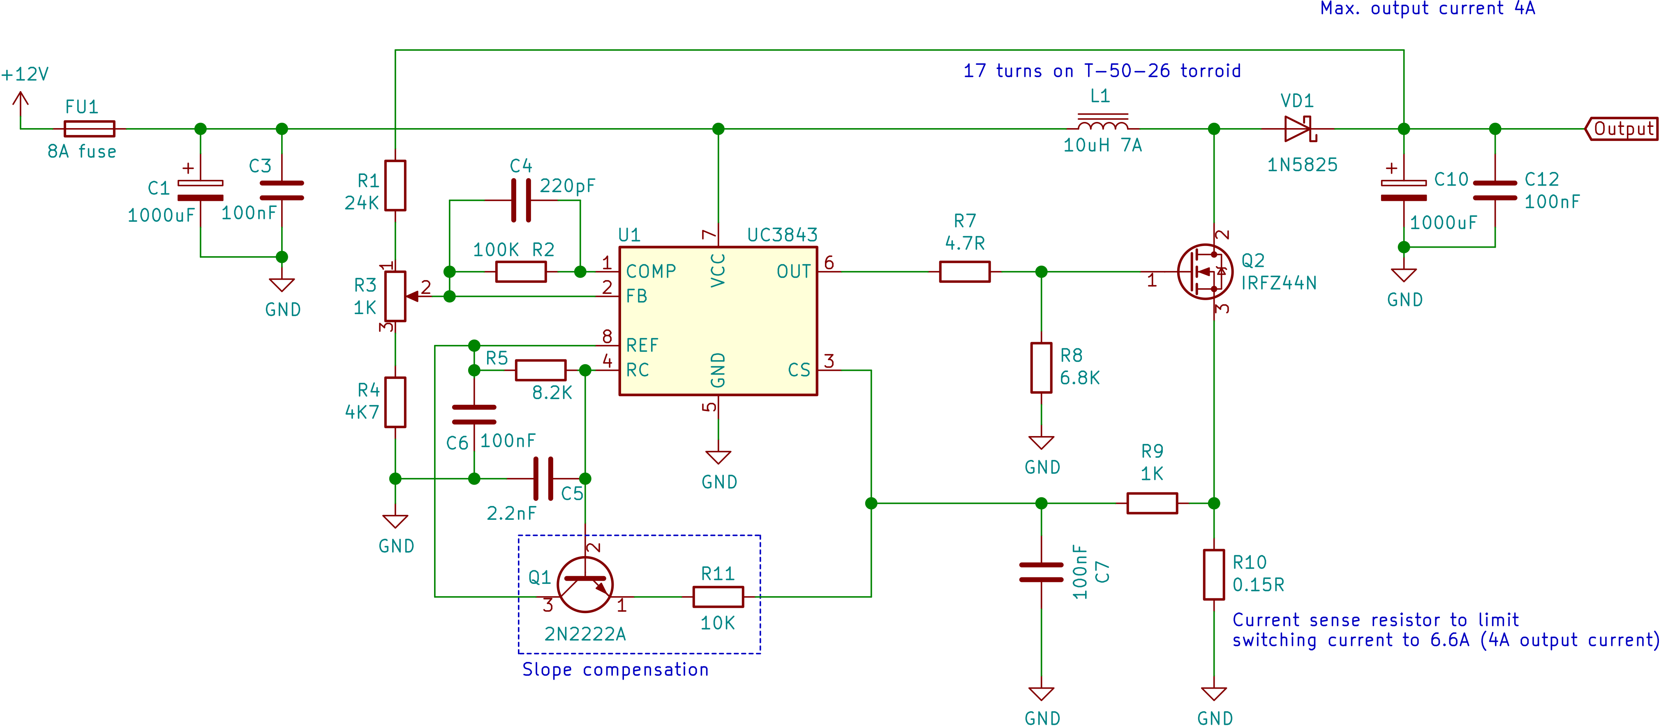
Controller: UC3843
Typical application circuit is simpler than the alternatives

Slide 11
Targeted Bonuses
Analog controller
Current-mode control
PCB
Industrial design
Negative efficiency bonus (joke)

Slide 12
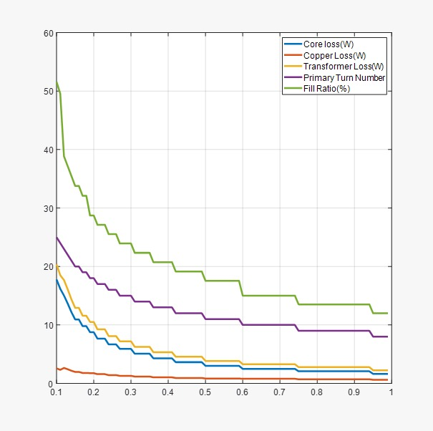
DCM limit graph for Vin = 18V

Slide 13
Discussion
We designed the circuit to stay in the CCM mode for 10% - 100% load. However, the core losses came out to be very high (17.79W). Then, we decreased the magnetizing inductance to stay in CCM for 25% load. The core losses decreased to 6.68W. Can we pull the DCM limit to higher load conditions to increase the efficiency?
Can this core dissipate this much heat without any burn?
Kool MU or ferrite + air gap?
Is it sufficient to use Steinmetz's equation to calculate core losses?

